Slide 1

Welcome to the World of Programming!

Slide 2
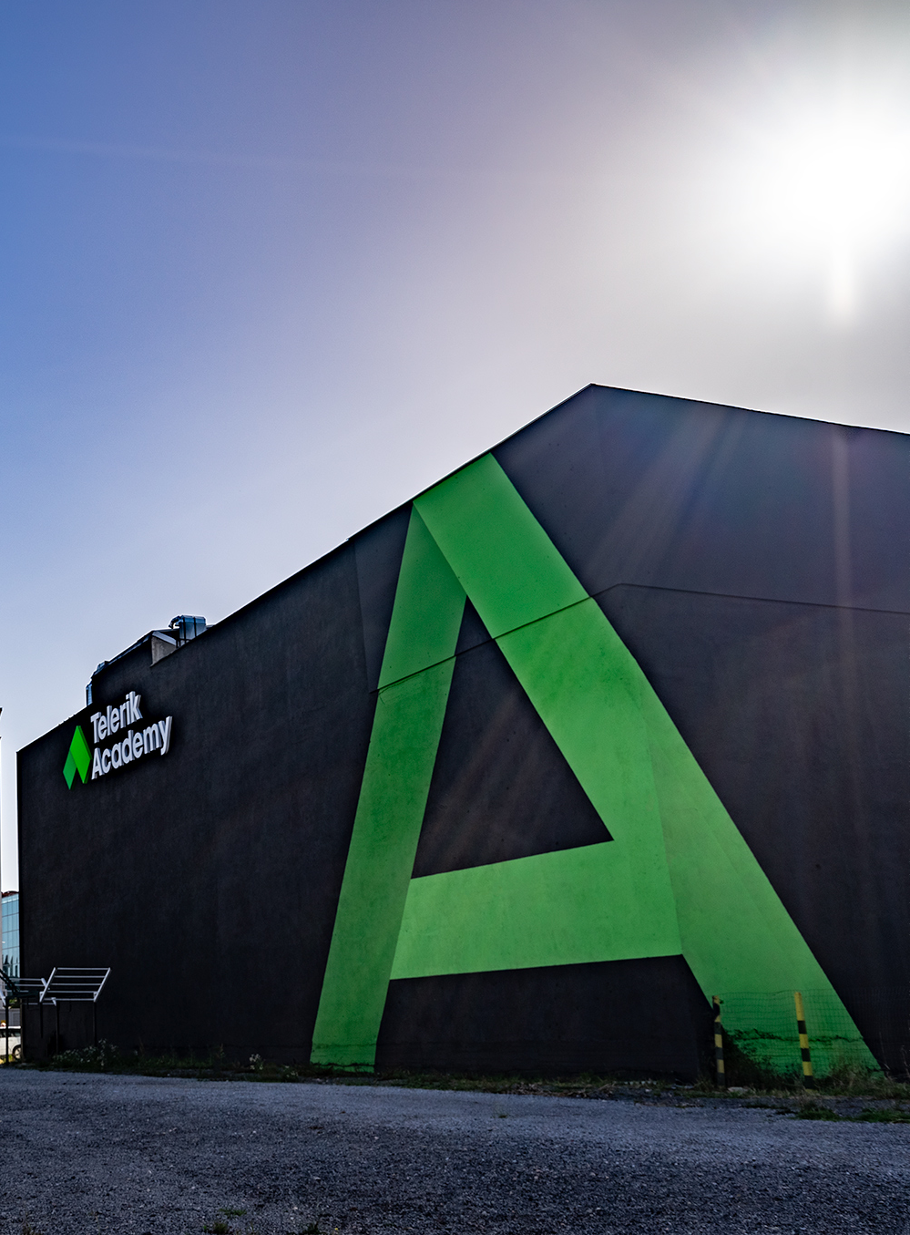
We are Telerik Academy
Since 2009 Telerik Academy has been providing candidates with the skills that the IT sector needs.
140,000-strong community
Each year, 600+ people change or accelerate their careers
99% of job-seeking Alpha graduates get hired
97% live in Bulgaria
67% move on to the next level within their first year on the job

Slide 3
IT Career = Endless possibilities

Slide 4

Future-proof industry
The IT sector serves the full spectrum of businesses around the world
Almost everything around us runs on software, and today, we are even more reliant on it - for work, communication, and leisure time
It allows for an easy transition to work from home - you can work from anywhere, if you have a stable internet connection
Digital transformation is now imperative for the future of almost every business

Slide 5

“
Whether we're fighting climate change or going to space, everything is moved forward by computers, and we don't have enough people who can code. I learned how to fly a hot air balloon when I was 30,000 feet up and my life was in the balance: you can learn skills at any age but why wait when we can teach everyone to code now!
Sir Richard Branson, founder Virgin Group

Slide 6

Profession: developer… and is it for me?
A developer is someone who has the creative and tech skills to create software programs.
Whether it is for you - If you are ready to learn new skills, you enjoy solving problems working with people on fascinating projects. Then you are off to a good start!
Still, the best way to find out if it is for you is to start coding.
Let me tell you how it all started for me...

Slide 7

Endless opportunities – just a few of them
High demand and salary
A variety of career options
Future-proof and valuable skills
Work from anywhere
Changе people’s lives
Flex hours
A creative career
Work collaboratively and individually
Always learning

Slide 8
The Telerik Academy Alpha difference

Slide 9
What is Telerik Academy Alpha?
A 6-month holistic program that will equip you with the real-world practical knowledge, and key interpersonal skills tech companies demand.

Slide 10

“The beginning is always the hardest, but Telerik Academy knows the shortest path to your successful IT career.”
Alek Hristov, Senior Software Engineer

Slide 11
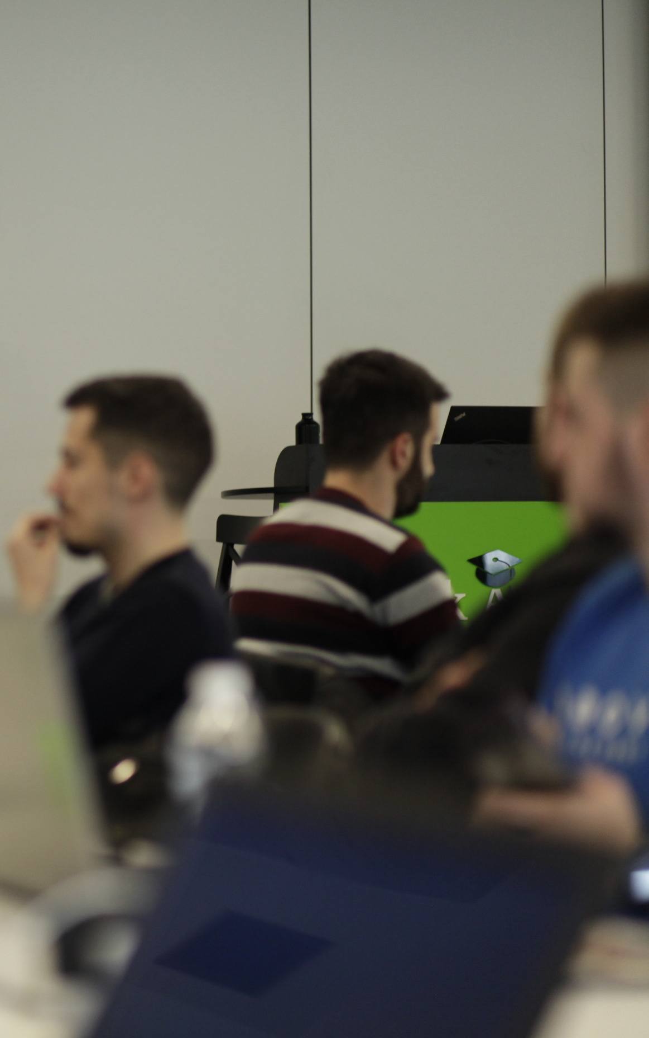
But also…
Group of 40-45 students with personalized training approach and individual development plans
800+ hours of engaging learning content, trainer-guided practical experience and hands-on problem solving of real-life challenges
Soft skills sessions
Mentor programs
An inside look into the IT industry

Slide 12
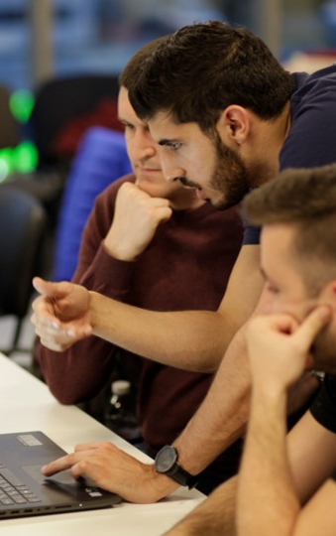
Learning Process
Learning format
Both in-home and in-class activities
Buddy groups of 6-7 people / Teams of 2-3
Group challenges and team projects
Technical and soft-skills guidance
Progress assessment
Individual progress reports, peer feedback
Continuous use of quizzes, tasks, workshops and projects
Individual assessment via trainer meetings and discussions

Slide 13

Buddy Groups and Mentors

Slide 14
What does a Holistic Program mean?

Slide 15

Hard skills could get you hired, but poor soft skills could get you fired.

Slide 16

Career Jumpstart Services
Technical interview preparation
Personalized feedback and expert review of your CV
Participation in our Career Days
Bridge to mentors and alumni who share their tested job-hunting strategies
Career coaching on your job search strategy and career exploration
Tips on how to rock the important first months on the job

Slide 17
Student Success

Slide 18

∞
Telerik Academy Alpha success stories

Slide 19
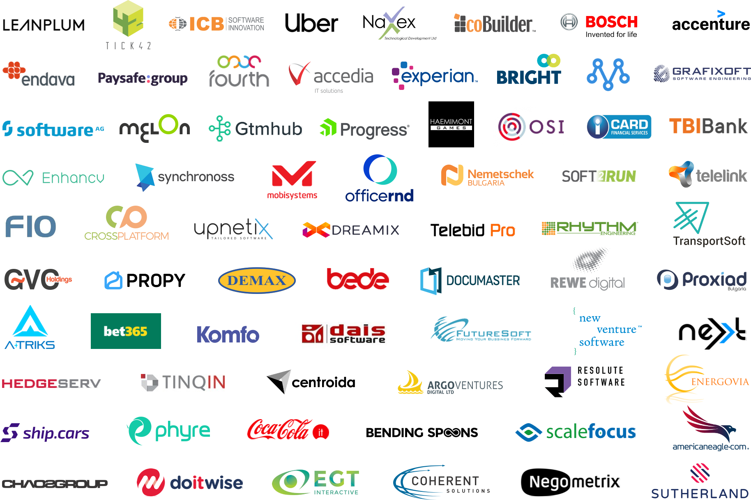
Our graduates fuel the teams of:

Slide 20
Q&A

